Slide 1



Super Store Product Analysis

Slide 2

Learning Objectives
To perform loading, cleaning and transformation of data using Power BI.
To learn how to create and customize various charts and advanced visualizations.
To modify chart colors,add visual box,shadow and change background color.
Learn how to use slicers and filters for creating interactive dashboards.
GOAL
Source :
www.freepik.com/

Slide 3
Tools and Technology used
Bar charts were utilized by assigning data to the x-axis and y-axis fields accordingly.
Line charts were employed to identify trends and derive new insights.
Pie charts were used for data comparison and analysis.
Additionally, various visualization tools such as tree maps, funnels, cards, and donut charts were applied to analyze the data effectively.

Slide 4
Methodology
In the visualizations tab, the first step is to choose the desired chart type to analyze the data.
Next, you need to add fields to represent the data on the x-axis and y-axis.
Filters can also be applied to display the top N data points.
Additionally, you can customize various elements, such as canvas color, text color, and background settings.
Finally, by creating a dashboard, you can display all the charts on a single page.

Slide 5
Problem Statement:
The goal is to analyze the superstore dataset to understand sales fluctuations and estimate the profitability of products sold across different regions, categories, and customer segments.

Slide 6
Solution:
The superstores dataset has been analyzed to uncover new trends and generate valuable insights.
This analysis provides a deeper understanding of the data, allowing for real-time evaluation.
Additionally, it offers flexibility in adding various data points and contributes to enhancing the overall sales performance.

Slide 7
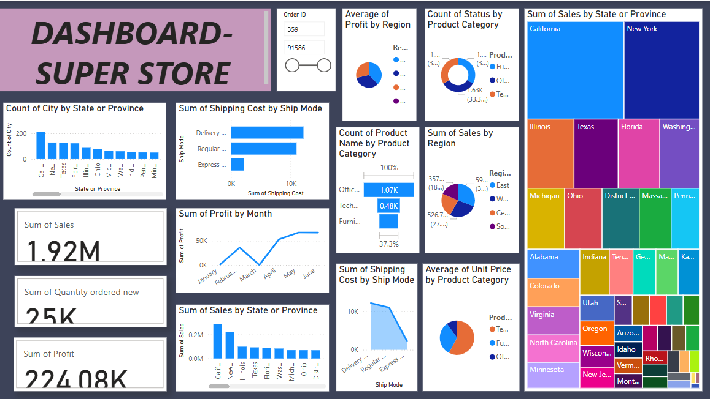
Screenshot of Output:

Slide 8
Conclusion:
Successfully imported, cleaned and transformed raw data using Power BI for analysis.
Created various charts and graphs such as bar chart, line chart, pie chart, donut chart, cards and treemaps.
Designed interactive dashboard for better understanding.

